Slide 1
Become a Sponsor @ Destinations & Boat Life!
boot Düsseldorf 2026 | halls 13 & 14

Slide 2
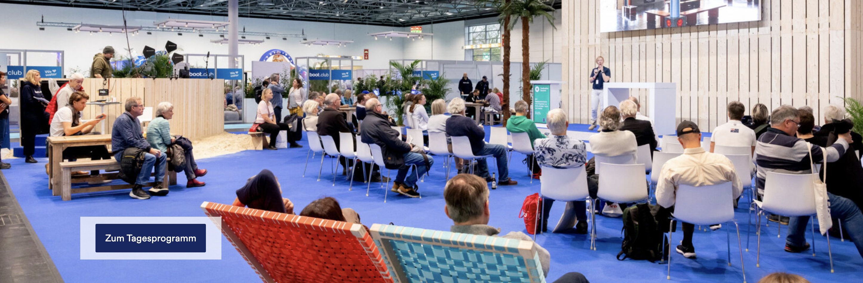
Themed area Destinations & Boat Life (halls 13 & 14)
“Fulfil your dream of a perfect water holiday trip!”
In Halls 13 and 14, visitors will find the best providers for travel and charter. Whether enjoying the best time of the year by the sea, feeling the elements on the next sailing trip or relaxing on a houseboat or floating home – in these halls everybody finds endless inspiration for his next holiday trip.
The travel marketplace is complemented by lectures, interviews and tips from exhibitors and experts. Every afternoon there will be a thematic focus on the main stage: Greece, Balearic Islands/Mallorca, Croatia or Caribbean – just to name a few.
We look forward to inspiring
you with this proven
concept and would like to
present the exclusive
sponsorship opportunities available to you as follows.

Slide 3
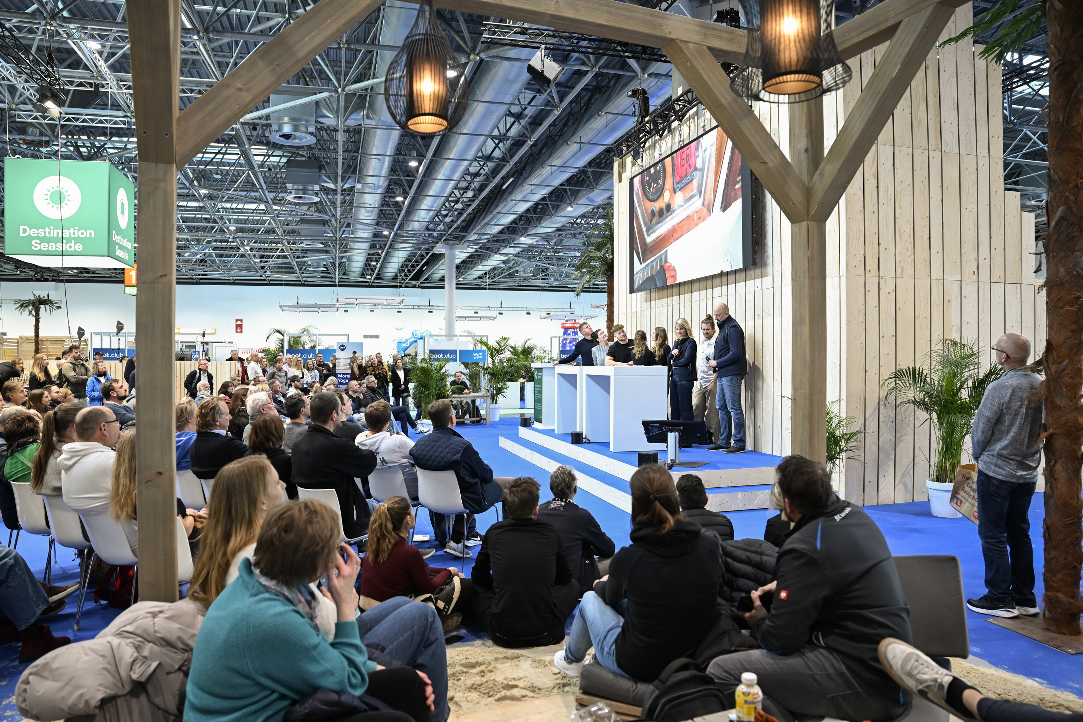
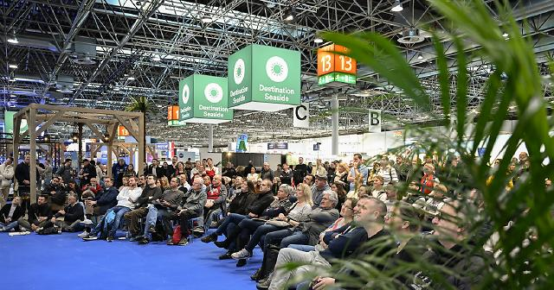
Opportunity 1: Destination Day
Name sponsoring “Destination Day”
Extended stage slots for your offer (before 4 p.m.)
Branded display material on stage
Marketing videos on screen throughout the day
Traditional music
Social media postings on the boot channels
€ 900

Slide 4
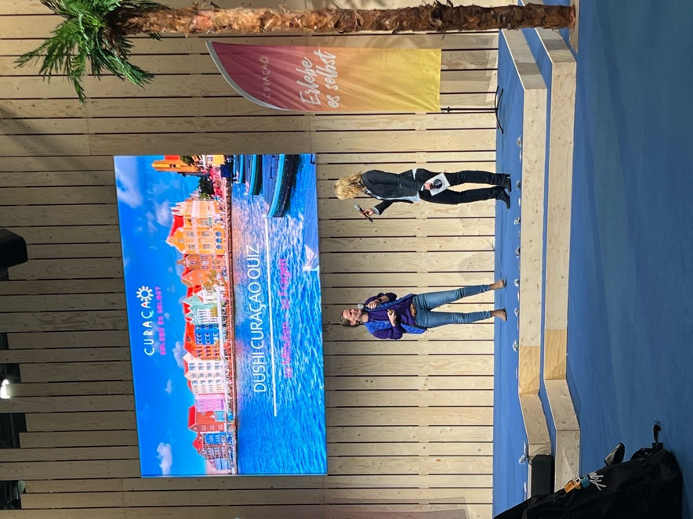
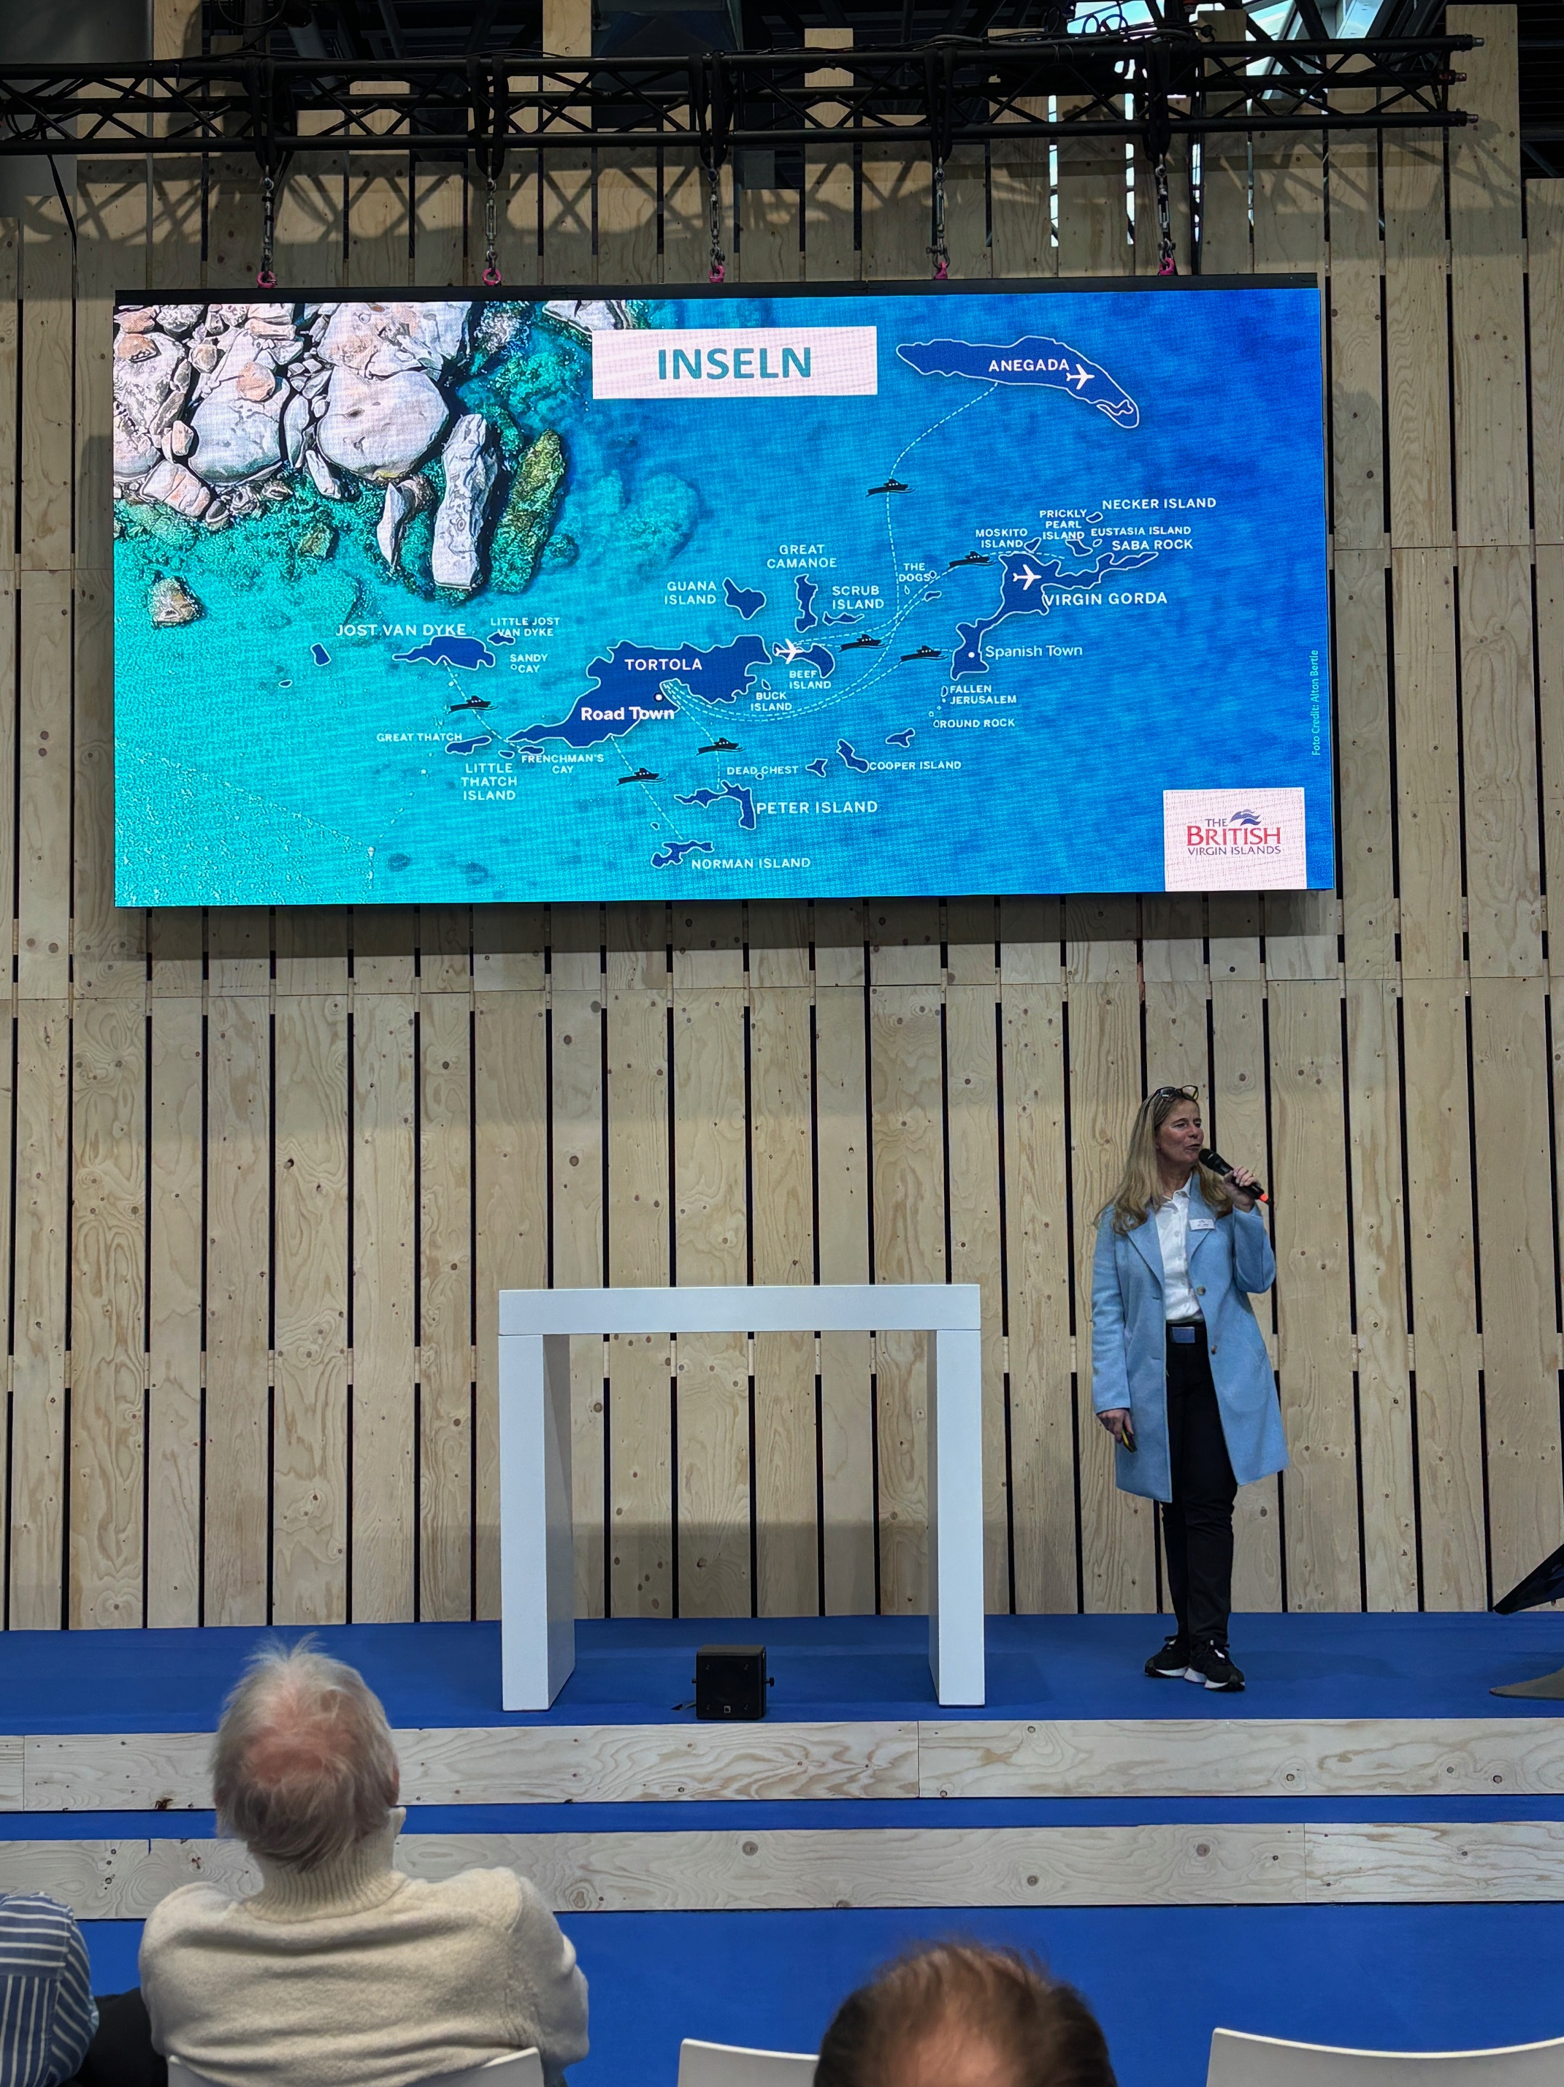
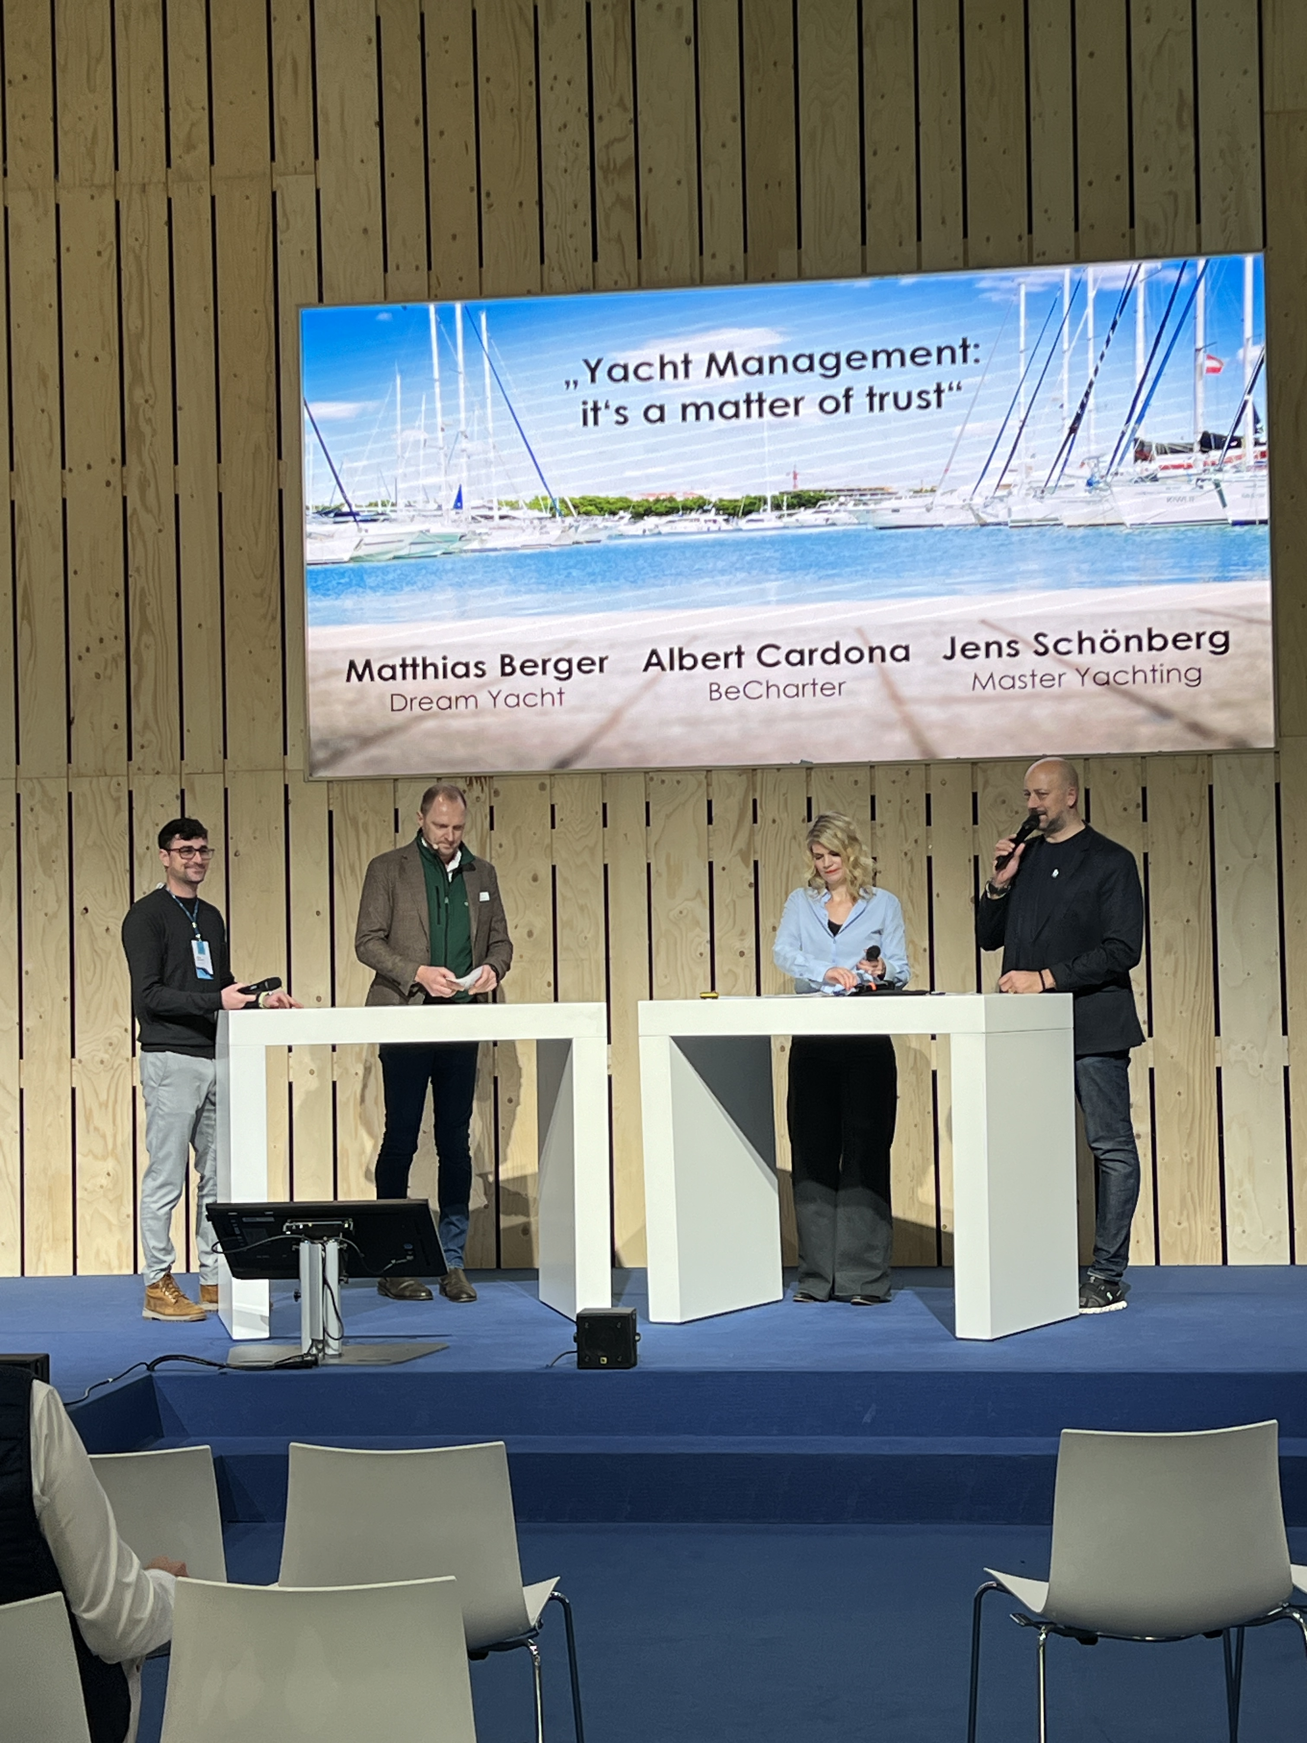
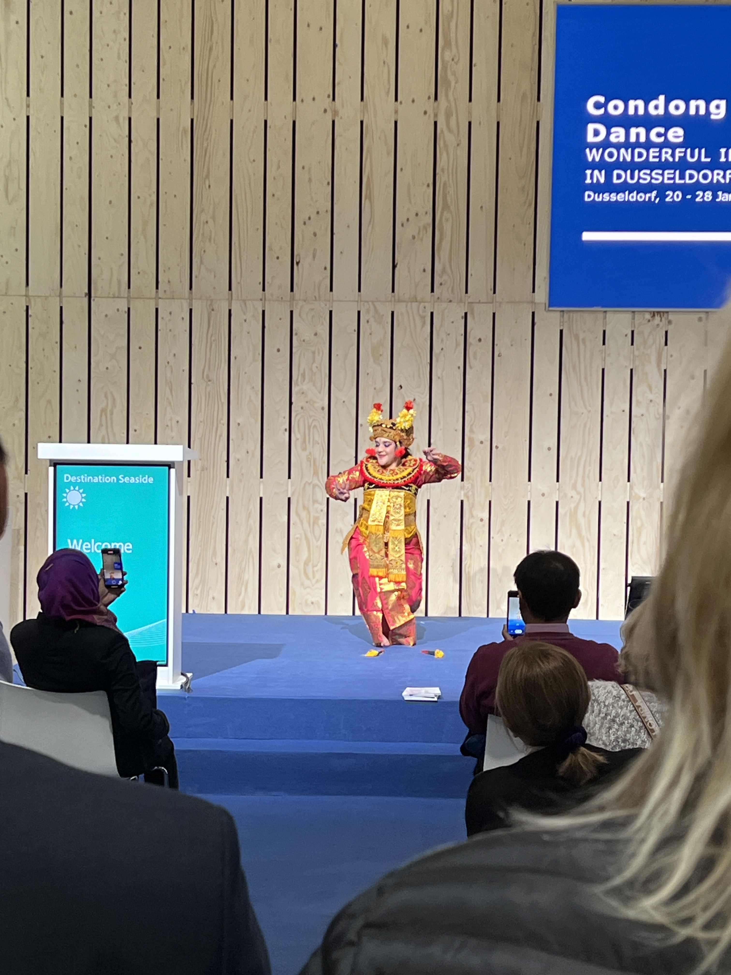
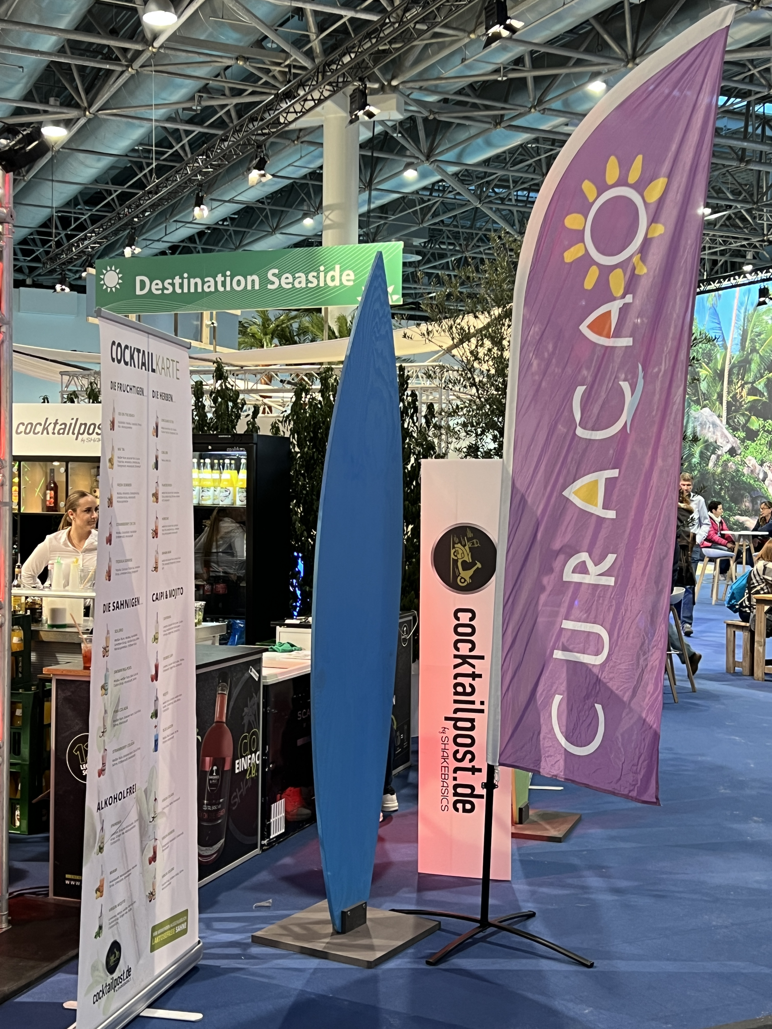
Your Destination Day
Name sponsoring of the stage area in Hall 13:
e. g. “Destination Day Greece”
Extended stage time of 60 minutes (4 x 15’) on
the booked day (before 4 p.m.)
Afternoon stage slots of other exhibitors will be planned with the same thematic focus
Complimentary announcements on the official social media channels of boot Düsseldorf (Instagram & Facebook)
Complimentary announcement on the website www.boot.de
Marketing videos and typical music will be played throughout the day*
Your choice of branded display material on stage*
We are happy to support you in planning
and implementation on site!
Offer valid for one exhibitor or more (as partners in a joint promotion)
* in responsibility of sponsor

Slide 5
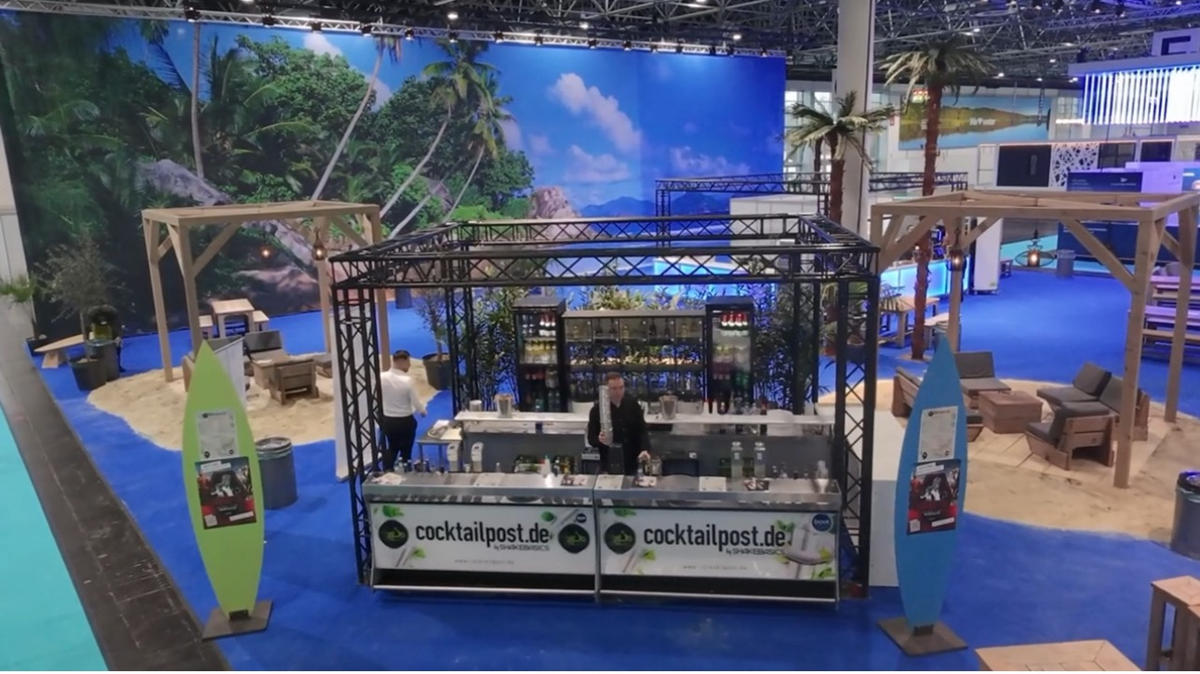
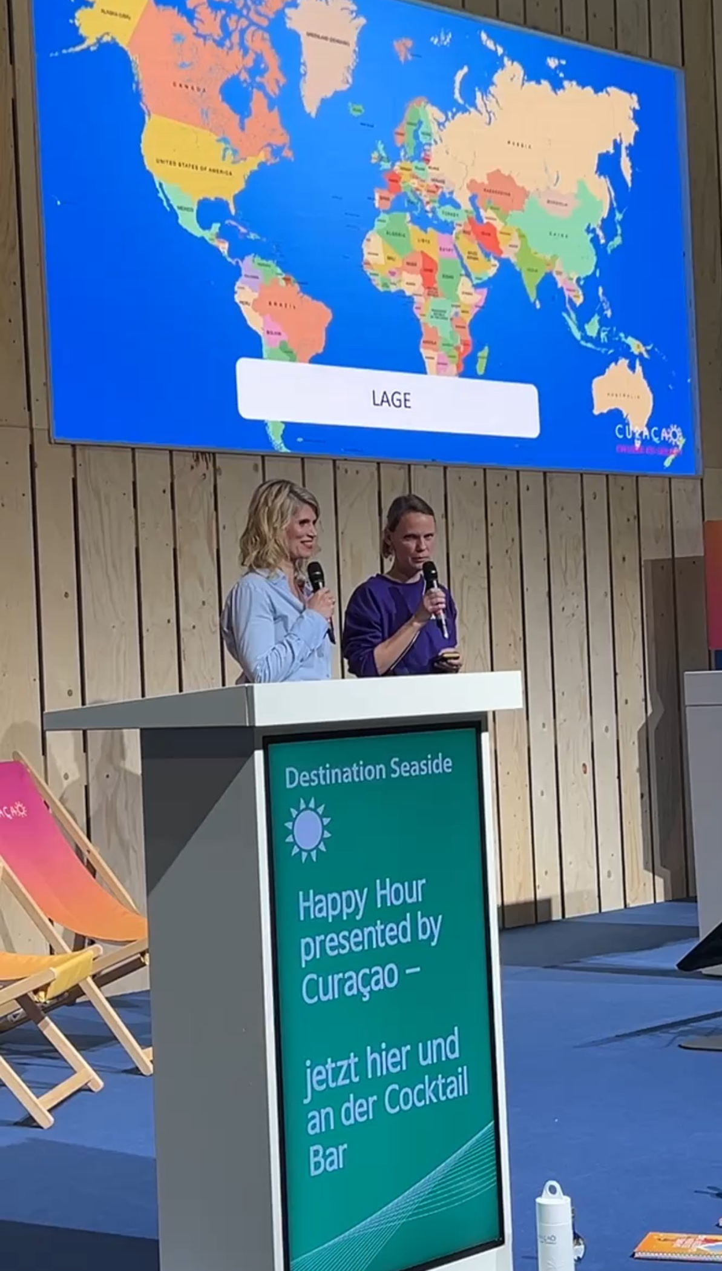
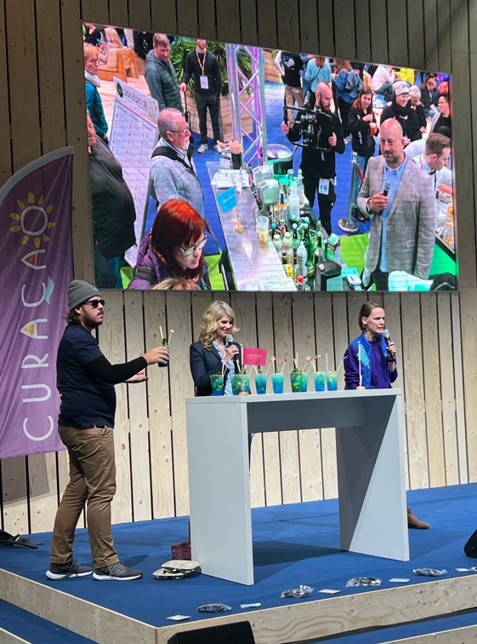
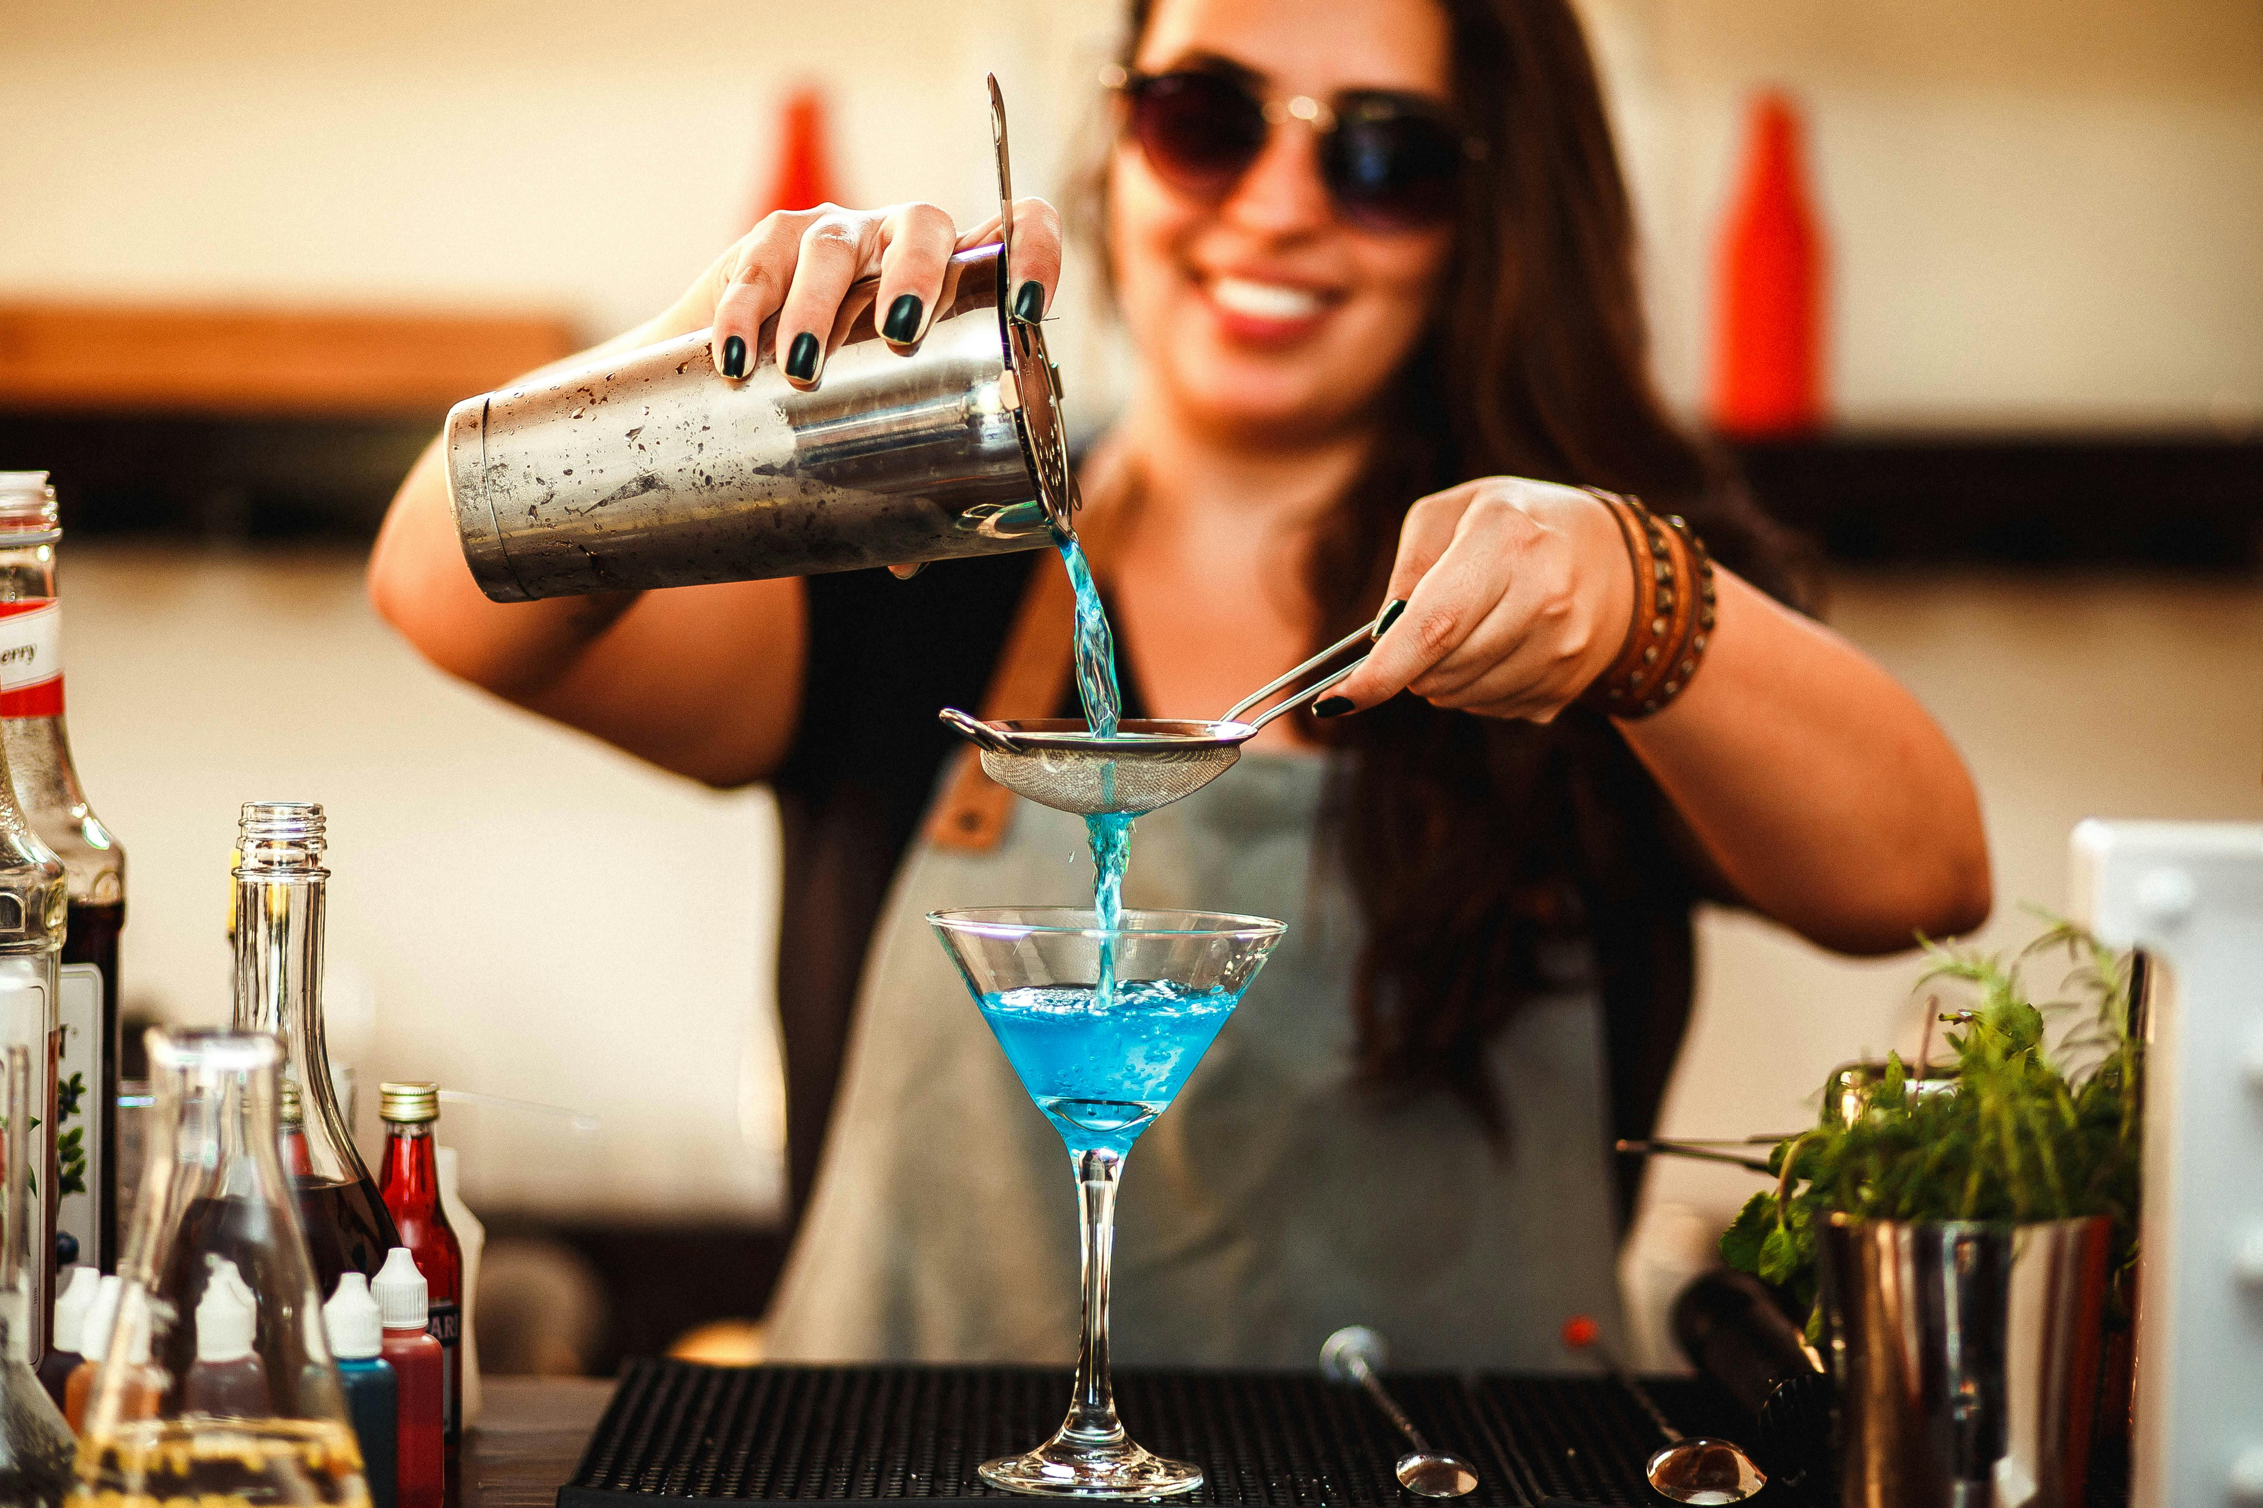
Opportunity 2: Sundowner
Program sponsoring “Sundowner”
Program sponsoring after 4:30 p.m.
Additional stage slots
Exclusive time on stage with expert Michael Amme
“Cocktail of the Day” at the bar next to the stage
Raffles for visitors
Get-together
€ 1,000

Slide 6
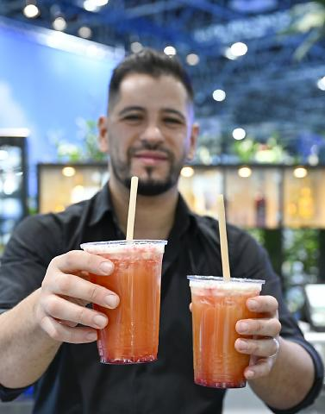
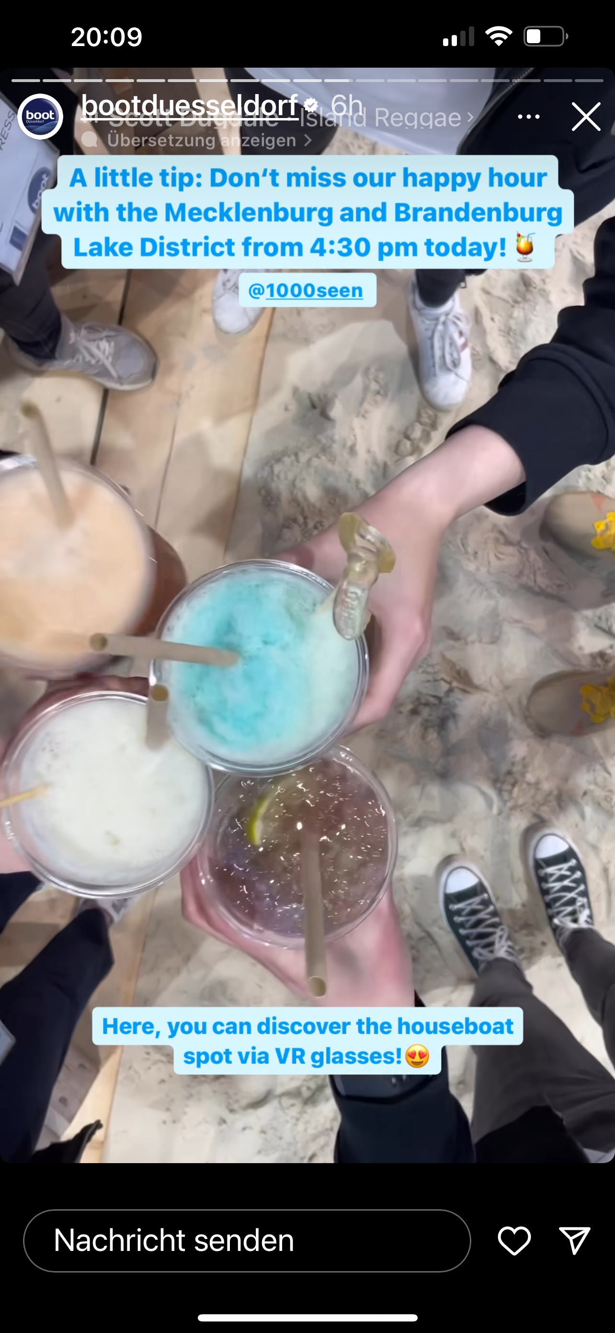
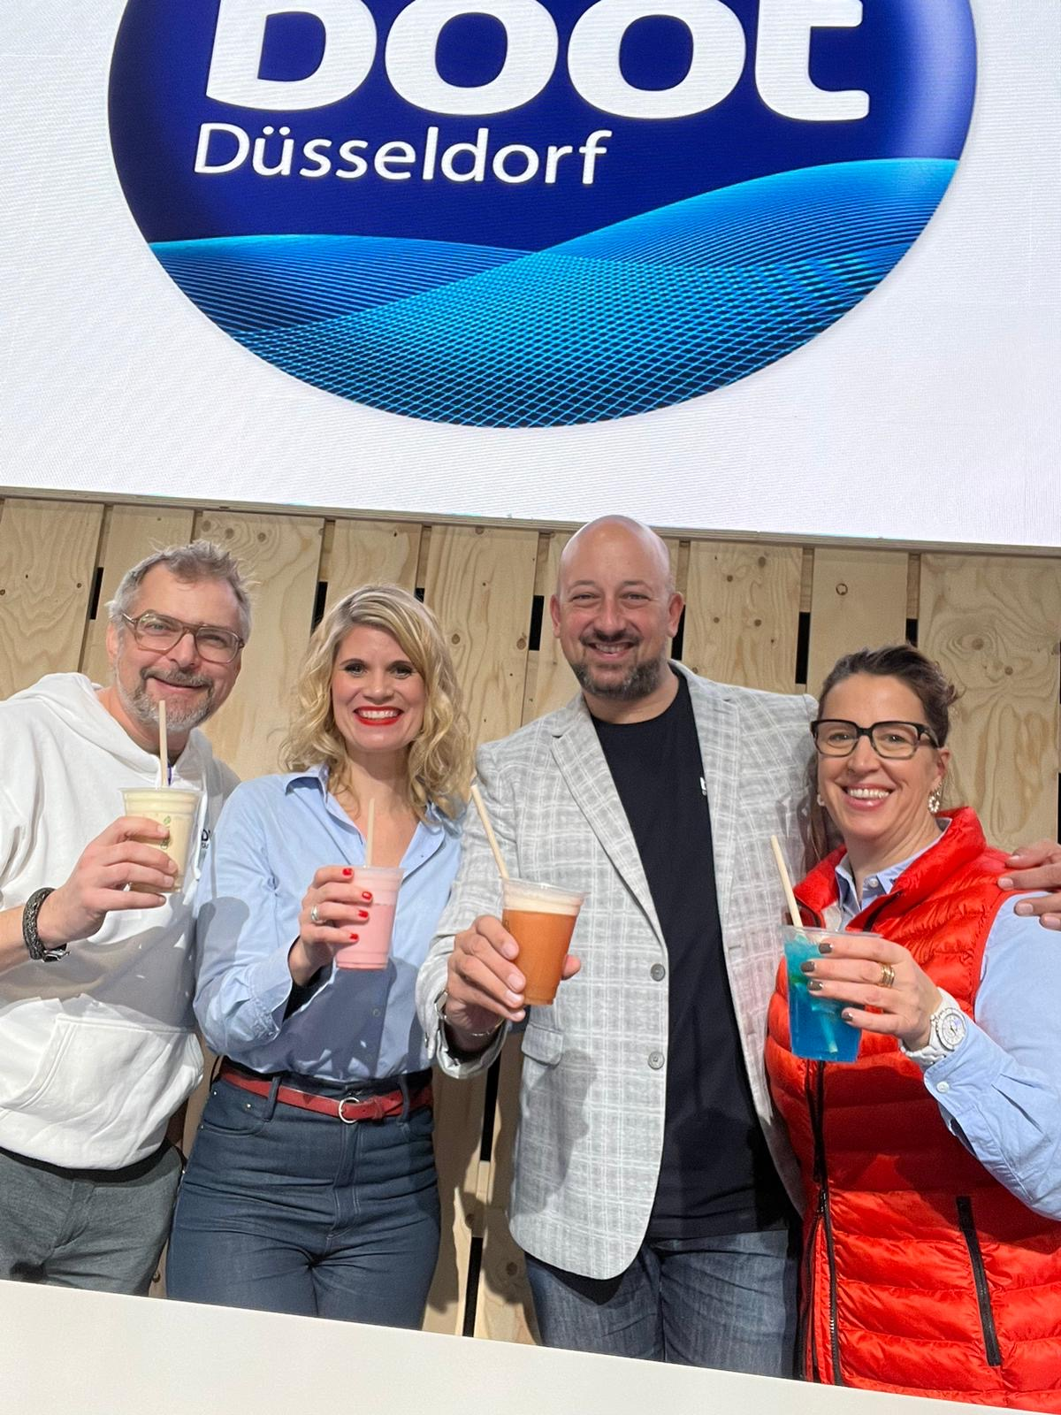
Your Sundowner
Program Sponsoring from 4:30 p. m. (e. g. “Greek Sundowner”)
Joint stage time with our expert Michael Amme and interview option
on stage after his every-day “sailing areas” presentation
Complimentary announcements on the official social media channels of boot Düsseldorf (Instagram & Facebook)
Complimentary announcement on the website www.boot.de
Traditional music can be played and cultural elements welcome (music, dance, readings …)*
“Cocktail of the day” offer at our Cocktail Bar next to the stage based on your typical recipe
Raffles for visitors on stage (your merchandising, cocktails …),
hosted by our moderators
Use the “Sundowner” for an exclusive friends & family get-together throughout the boot Happy Hour starting 6 p.m.!
We are happy to support you
in planning and implementation on site!
Offer valid for one exhibitor or more (as partners in a joint promotion)
* in responsibility of sponsor

Slide 7
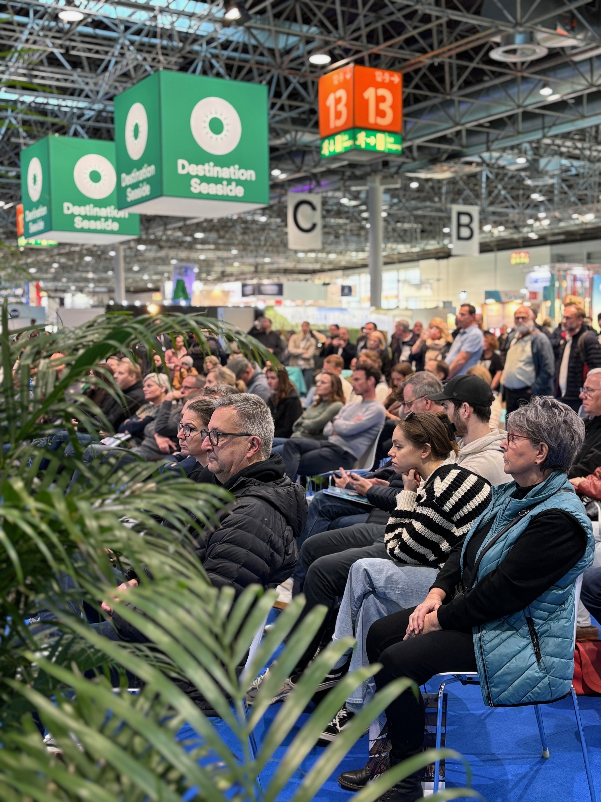
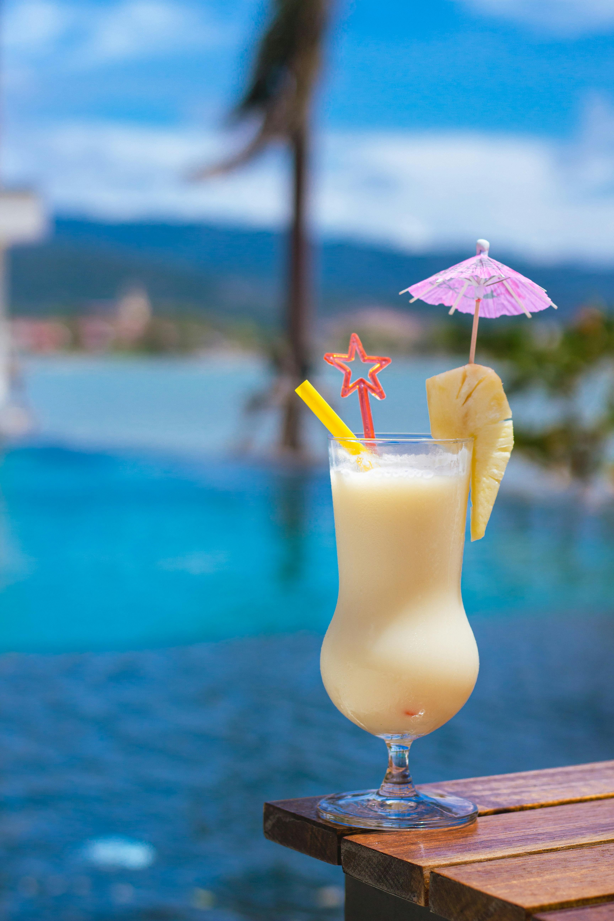
Opportunity 3: Sponsorship Combination
“All in”
Combination of
the named services:
Sponsoring of
the whole day
Destination Day
& Sundowner
€ 1,800

Slide 8
Book now:
LAACK PR
Anne Marei Laack
laack@destinations-boot.de
+49 (0)151-212 65 321

